Slide 1
Foreign Disclosure Request (FDR) Procedures
Required information for each Foreign National (FN) Visit
45 days prior to Visit
Purpose of the Visit
Date(s) of Visit
Country of Citizenship
Name(s) FNs
Company/Organization
Position/Job Title
Copies of current Passport (NOT EXPIRED) from the country they “hail” from
Area(s) the FN’s will be visiting while at Galveston District
Point of contact of USACE Employee responsible for the meeting
  ***SEND ALL EMAIL PERTAINING TO PII ENCRYPTED***

Slide 2
Foreign Disclosure Request (FDR) Procedures
KEY NOTES:
Approval can take up to 45 days to process. Anything less than requires a waiver.
Signed copy of the FDR will be given to the requestor upon approval.
Provide roster of FNs for each day of visit/meeting.
Only FNs on the approved FDR will be given access to the facility(s). NO SUBSITUTIONS EXECEPTED!
FN’s will follow SWG Visitor sign-in procedures.
ALL FNs will be escorted.
The POC will notify the Guard Supervisor of the FN Visit.
Security Lead’s Email - securitylead@meritussolutionsgroup.com
  ***SEND ALL EMAIL PERTAINING TO PII ENCRYPTED***

Slide 3
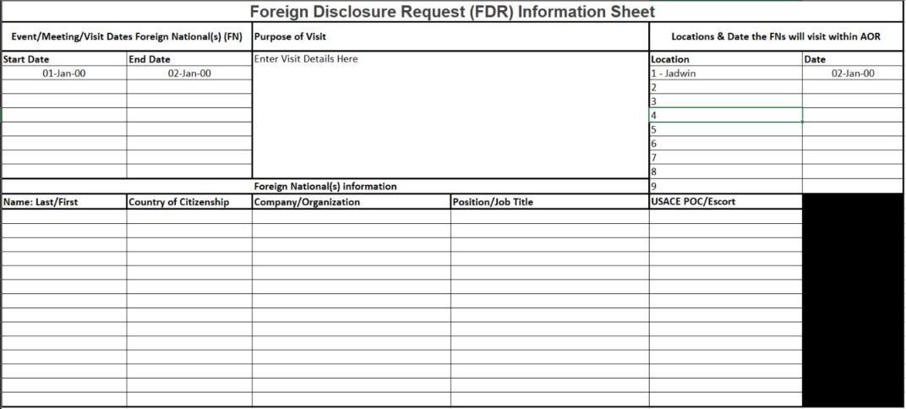
Foreign Disclosure Request (FDR) Procedures Continued

